Slide 1

Zero-Shot No-Reference Image Quality Assessment
Itai Antebi
Advised by: Professor Michal Irani
A thesis for the degree Master of Science Submitted to the Scientific Council of the Weizmann Institute of Science.
8 November 2023

Slide 2


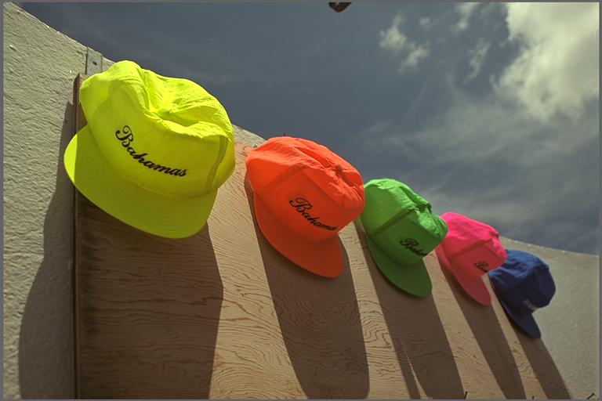

IQA Motivation – reverse problems
Degraded Input
Prediction
Reverse Method
IQA score:
PSNR
SSIM
Perceptual
GT Reference
Degradation

Slide 3
IQA Goal: Objective measure that mimics human perception

Slide 4
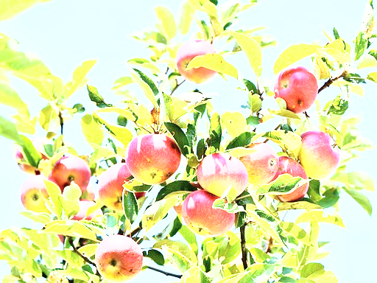
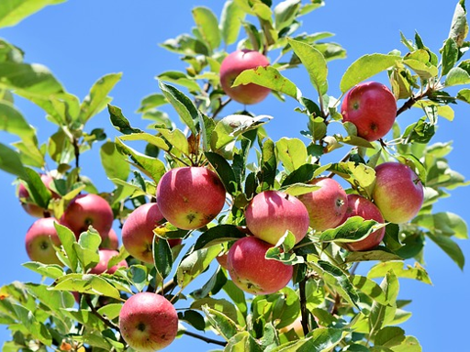

IQA Motivation – reverse problems
Degraded Input
Prediction
Reverse Method
IQA score:
PSNR
SSIM
LPIPS
GT Reference
Degradation

Slide 5
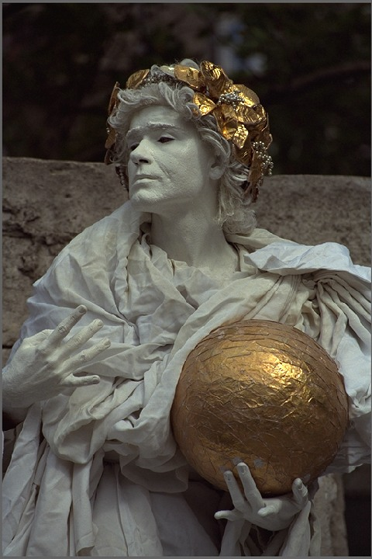


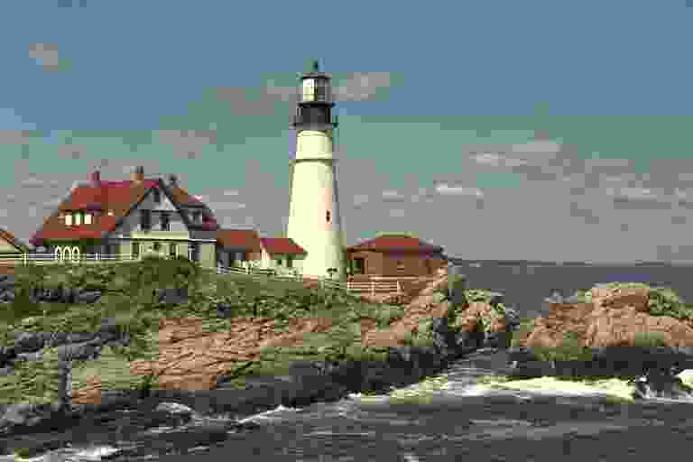
No-Reference IQA
How “good” are these images?

Slide 6


No-Reference IQA
50
21
97

Slide 7

No-Reference IQA
Dataset:
Types of distortions
Number of images, Image size, Score range…
{$\left( , 97\right), \left( , 50\right),\left( , 21\right), …$}

Slide 8


Current SotA NR-IQA
Method:
$$59$$
$$50$$
Pred
GT

Slide 9
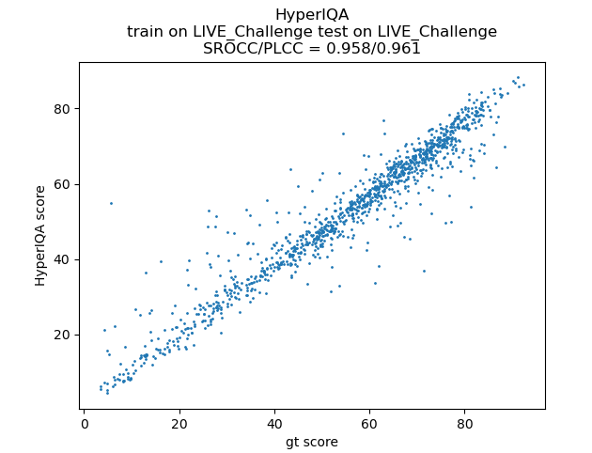
Current SotA NR-IQA
Evaluation:

Slide 10
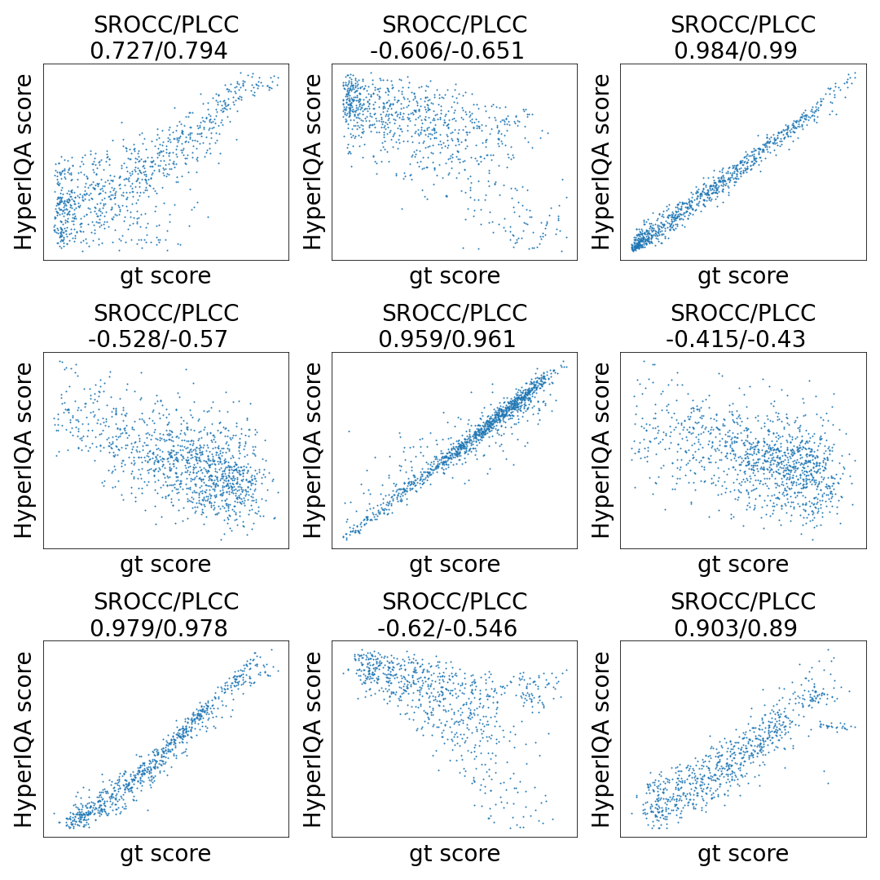
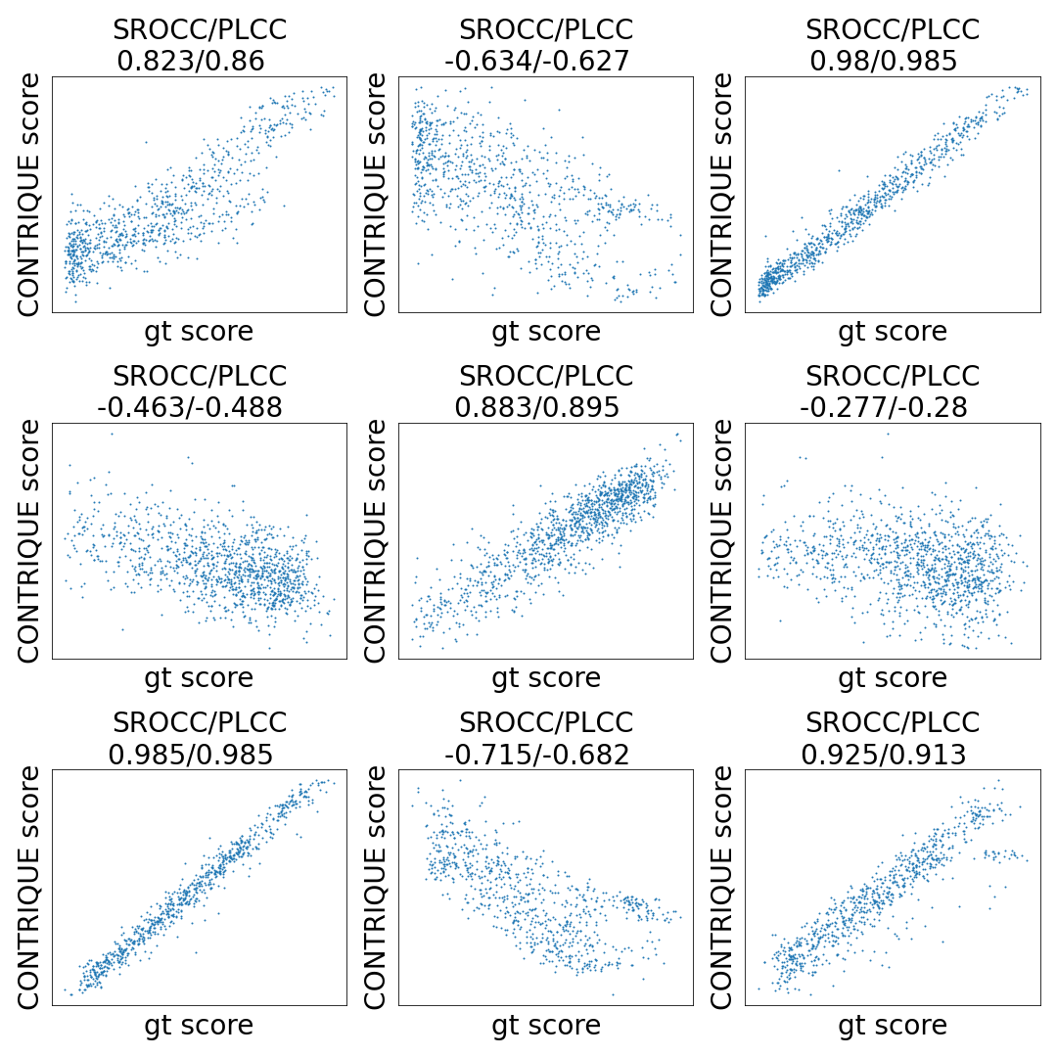
Current SotA NR-IQA
Hyper IQA
CONTRIQUE
LIVE
LIVE_C
CSIQ
LIVE
LIVE_C
CSIQ
Test Dataset
Test Dataset
LIVE
LIVE_C
CSIQ
LIVE
LIVE_C
CSIQ
Train Dataset
Train Dataset

Slide 11
Our Goal: Zero-Shot No-Reference IQA

Slide 12
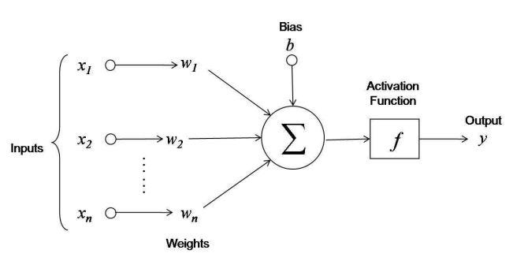
Disclaimer

Slide 13

Method overview
Input Image

Slide 14
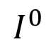
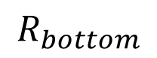
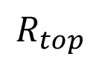
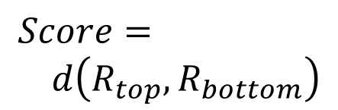
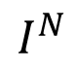
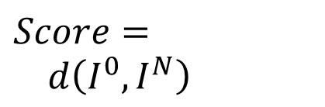
Method overview
Weighted SWD
Results & Discussion
Recurrence Histogram
Introduction
LR Supervision
$$R_{top}$$
Degraded Input
$$I^{0}$$
Increasing Quality
$$Score= \\ d\left(I^{0},I^{N}\right)$$
$$Score= \\ d\left(R_{top},R_{bottom}\right)$$
High Quality
$$R_{bottom}$$
$$I^{N}$$

Slide 15
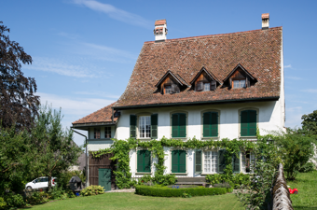

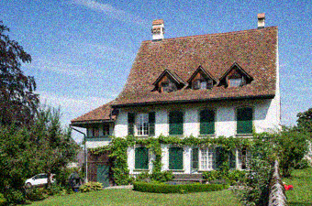















Introduction
Weighted SWD
Results & Discussion
LR Supervision
Recurrence Histogram
High Quality
Blur
Noise
High Resolution
Low Resolution

Slide 16
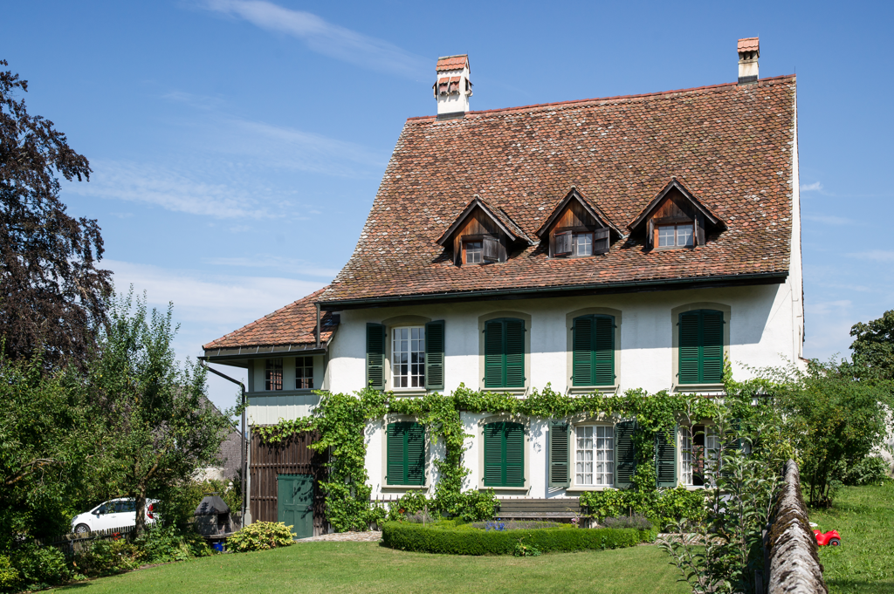
High Quality

Slide 17

Blur

Slide 18
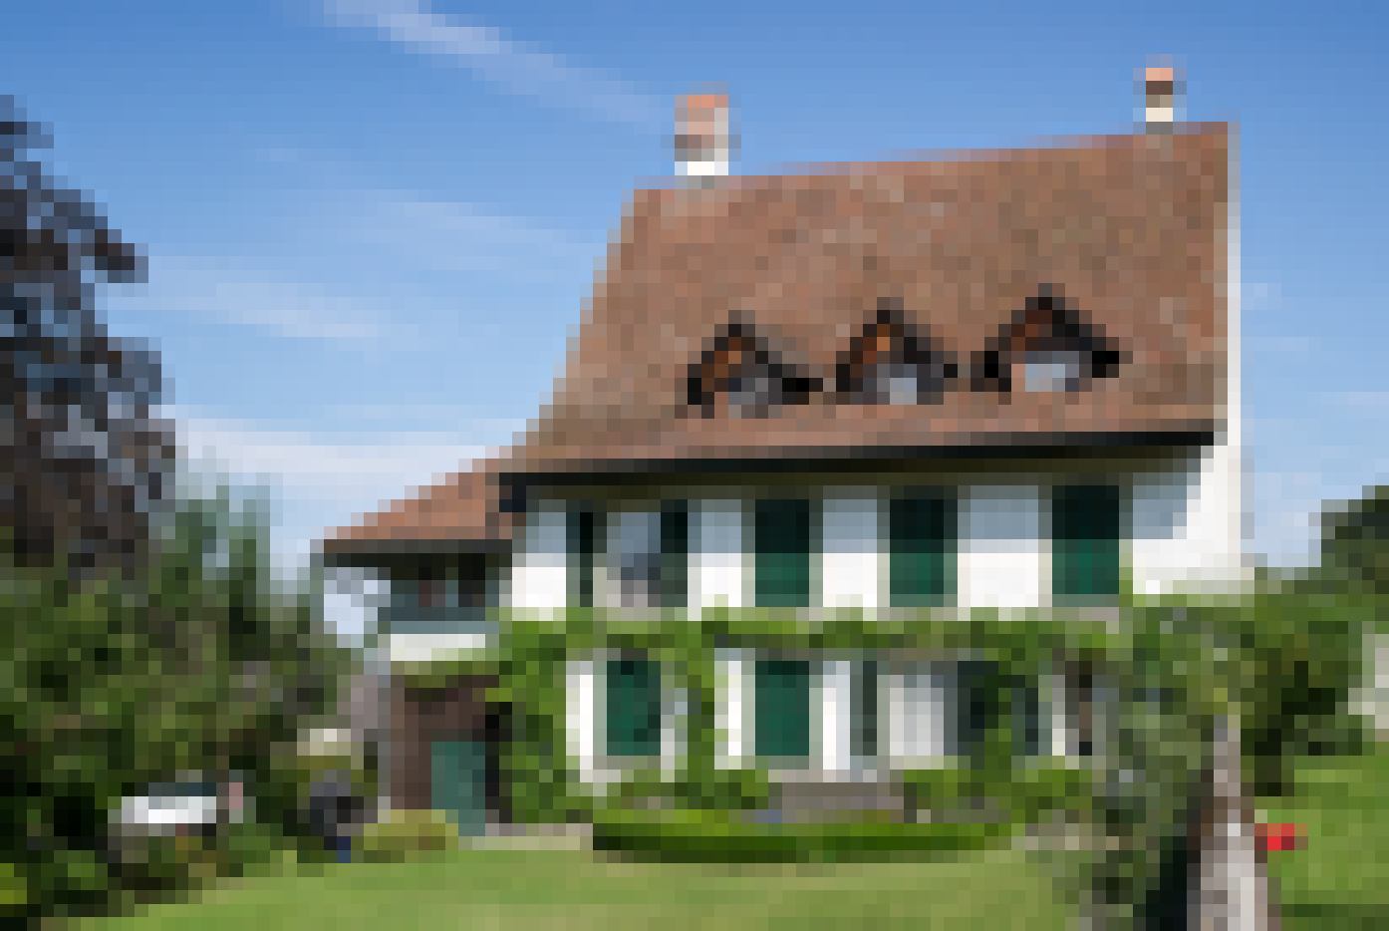
High Quality

Slide 19

Blur

Slide 20
Method overview
Introduction
Weighted SWD
Results & Discussion
Recurrence Histogram
LR Supervision
Introduction
Weighted SWD
Results & Discussion
LR Supervision
Recurrence Histogram
$$R_{top}$$
Degraded Input
Increasing Quality
$$Score= \\ d\left(R_{top},R_{bottom}\right)$$
High Quality
$$R_{bottom}$$

Slide 21
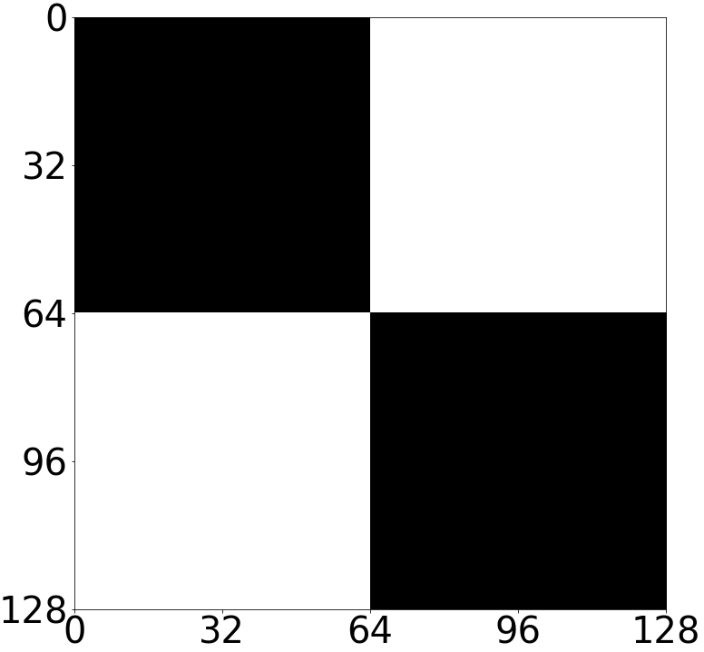
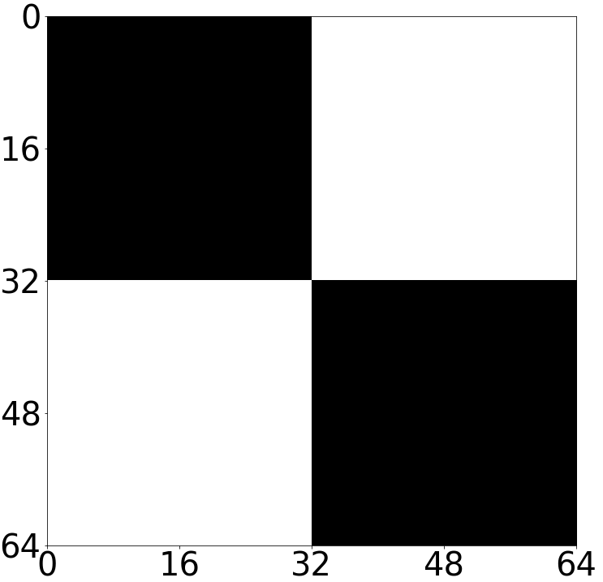
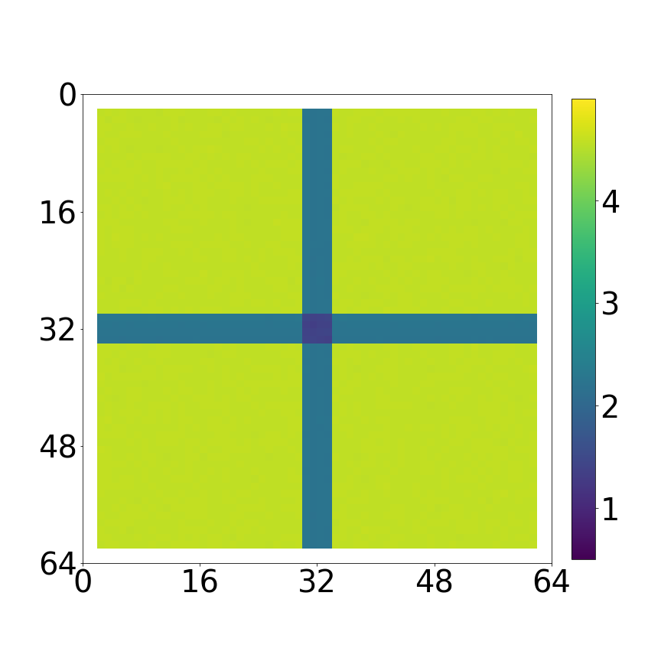
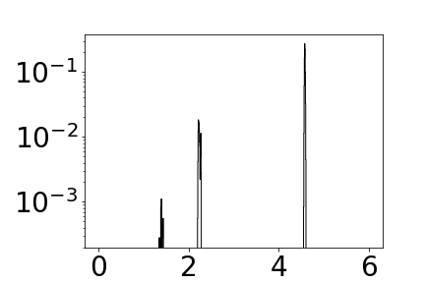
Recurrence Histogram – Toy Example
Introduction
Weighted SWD
Results & Discussion
Recurrence Histogram
LR Supervision
HR Image
LR Image
Recurrence Map
Recurrence Histogram

Slide 22



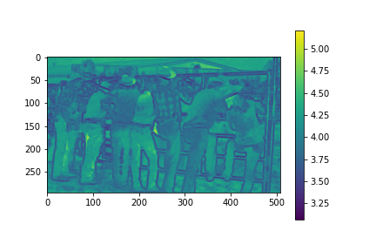
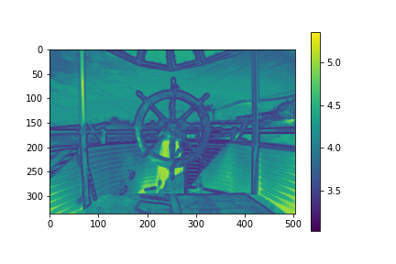
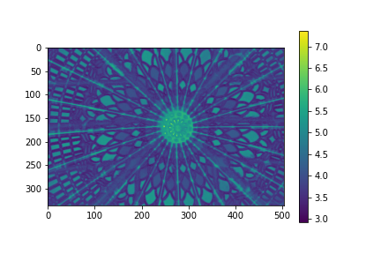
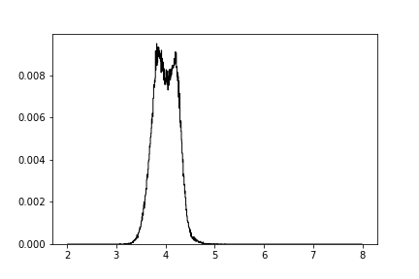
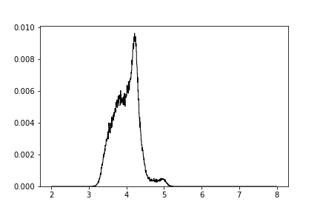
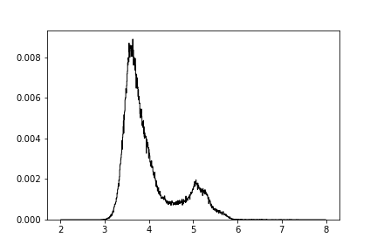
Recurrence Histogram – Natural Image
Introduction
Weighted SWD
Results & Discussion
Recurrence Histogram
LR Supervision

Slide 23
Method overview
Introduction
Weighted SWD
Results & Discussion
Recurrence Histogram
LR Supervision
$$R_{top}$$
Degraded Input
Increasing Quality
$$Score= \\ d\left(R_{top},R_{bottom}\right)$$
High Quality
$$R_{bottom}$$

Slide 24
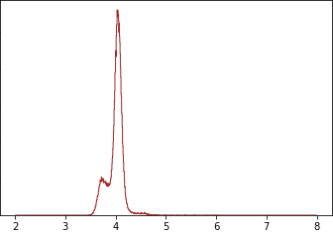
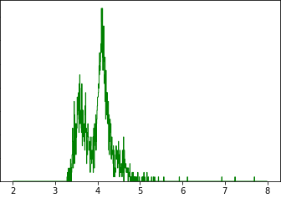
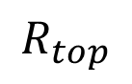
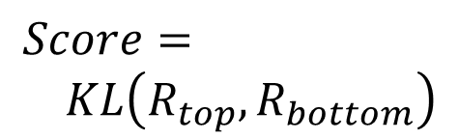
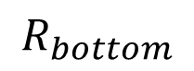
Method overview
Introduction
Weighted SWD
Results & Discussion
Recurrence Histogram
LR Supervision
Introduction
Results & Discussion
Weighted SWD
LR Supervision
Recurrence Histogram
$$R_{top}$$
Degraded Input
Increasing Quality
$$Score= \\ KL\left(R_{top},R_{bottom}\right)$$
$$Score= \\ d\left(R_{top},R_{bottom}\right)$$
High Quality
$$R_{bottom}$$

Slide 25


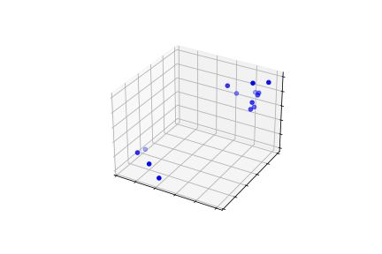
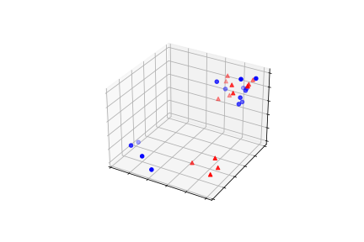



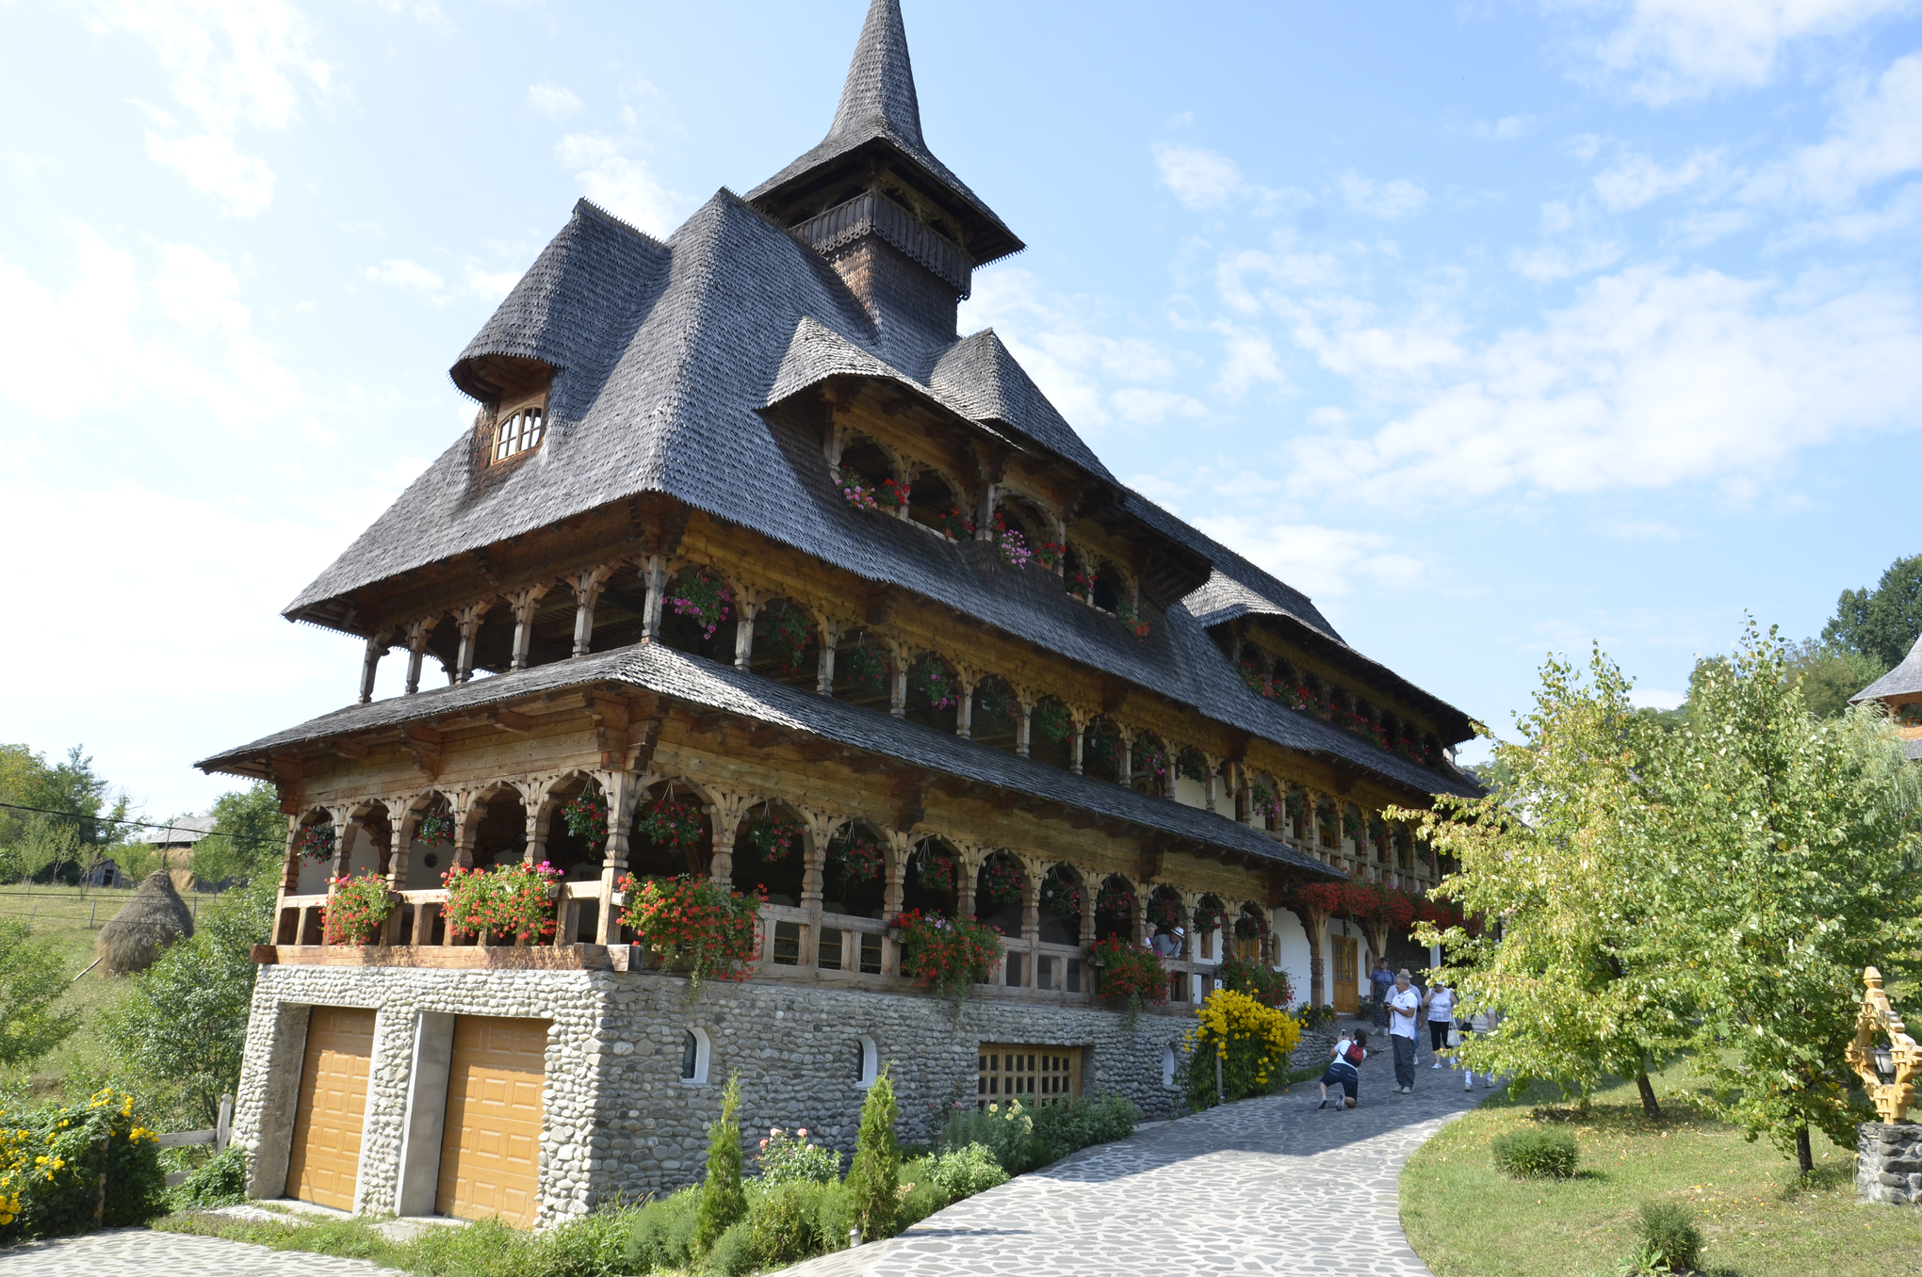




Patch Distribution
Introduction
Results & Discussion
Weighted SWD
LR Supervision
Recurrence Histogram
…
…

Slide 26
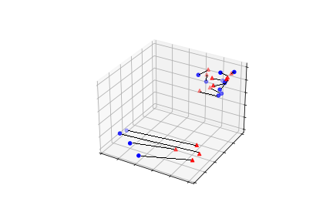
Wasserstein Distance
Introduction
Results & Discussion
Weighted SWD
LR Supervision
Recurrence Histogram
…
…

Slide 27
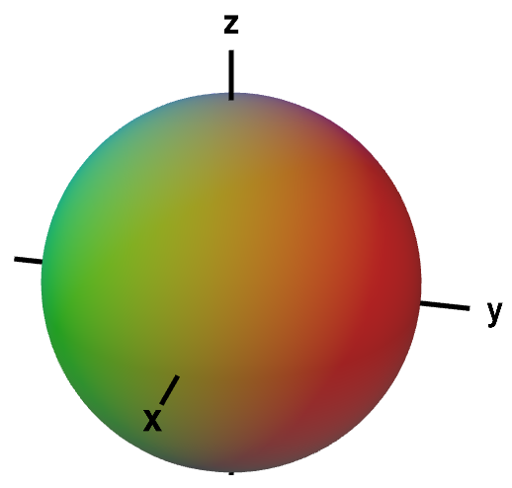
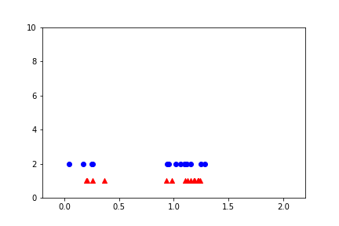
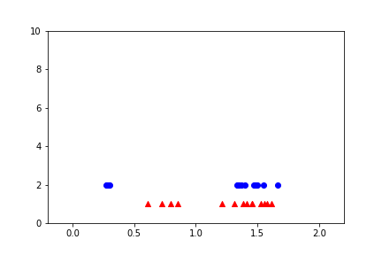
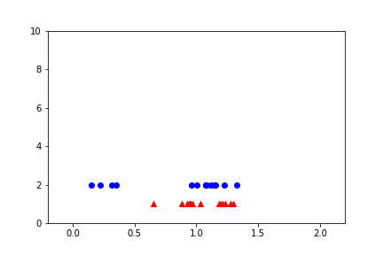
Sliced Wasserstein Distance (SWD)
Introduction
Results & Discussion
Weighted SWD
LR Supervision
Recurrence Histogram
…
…

Slide 28
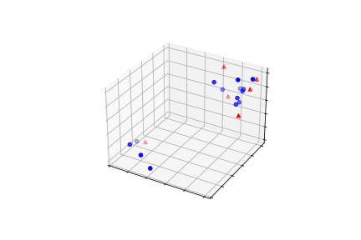



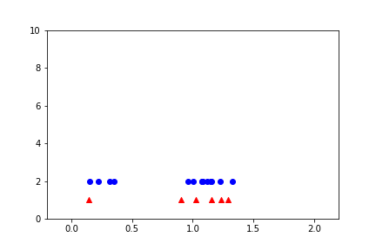

Sliced Wasserstein Distance (SWD)
Introduction
Results & Discussion
Weighted SWD
LR Supervision
Recurrence Histogram
…
…

Slide 29
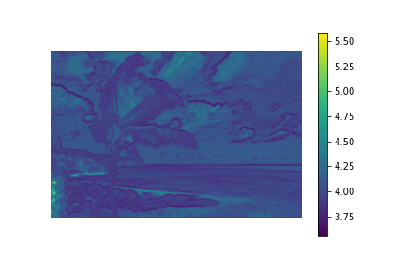
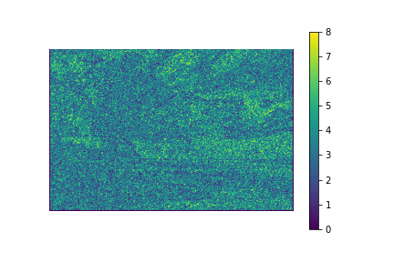
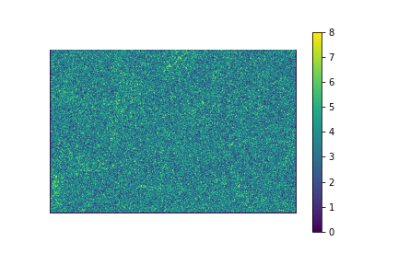
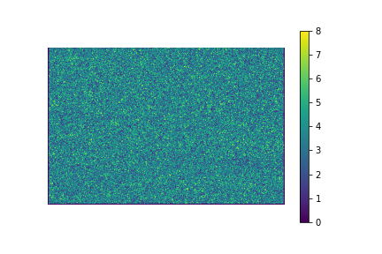
Weight Map that minimizes SWD
Introduction
Results & Discussion
Weighted SWD
LR Supervision
Recurrence Histogram

Slide 30
Weight Map that minimizes SWD
Introduction
Results & Discussion
Weighted SWD
LR Supervision
Recurrence Histogram

Slide 31
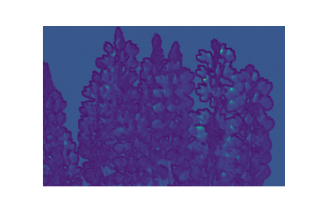
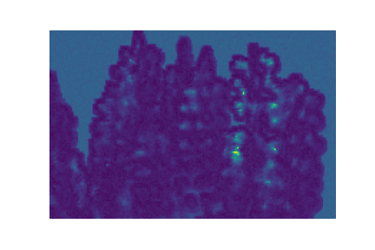

Method overview
Introduction
Results & Discussion
Weighted SWD
LR Supervision
Recurrence Histogram
Introduction
Results & Discussion
LR Supervision
Recurrence Histogram
Weighted SWD
$$R_{top}$$
Degraded Input
Increasing Quality
$$Score= \\ KL\left(R_{top},R_{bottom}\right)$$
High Quality
$$R_{bottom}$$

Slide 32







Results
Introduction
Results & Discussion
LR Supervision
Recurrence Histogram
Weighted SWD
Minor Degradation
Major Degradation
High Quality
Blur
Noise
Severity of Degradation

Slide 33
Results
Introduction
Results & Discussion
LR Supervision
Recurrence Histogram
Weighted SWD

Slide 34





Results
Introduction
Results & Discussion
LR Supervision
Recurrence Histogram
Weighted SWD
Non-vanishing degradations
Degradation too severe (for image size)
Blurred background

Slide 35




Results
Introduction
Results & Discussion
LR Supervision
Recurrence Histogram
Weighted SWD

Slide 36





Results
Introduction
Results & Discussion
LR Supervision
Recurrence Histogram
Weighted SWD

Slide 37
Summary
Introduction
Results & Discussion
LR Supervision
Recurrence Histogram
Weighted SWD
Zero-Shot NR-IQA
Patch Recurrence != Patch Distribution
Patch Recurrence Relation
High-Quality images → Relation is preserved across scales
Utilized Low-Resolution as High-Quality
Doesn’t suffer from generalization problems
Explainable
Insight

Slide 38
Future Directions
Introduction
Results & Discussion
LR Supervision
Recurrence Histogram
Weighted SWD
End-to-End differentiable
“Objective measure” for different degradations
Non-vanishing / Authentic distortions
Combine deep-learning / external constraints

Slide 39

Questions

Slide 40


Acknowledgements
Prof. Michal Irani
Dr. Shai Bagon

